Slide 1

HANDS-ON WITH REACT
Using External Data

Slide 2
Using external data
Sometimes your application will rely on external data – for example, you might need to use the result of an API call.
Let’s look at how to achieve this in React.
This will be a very simplified version of a challenge later in the section, but this will introduce you to the fetch API in react

Slide 3

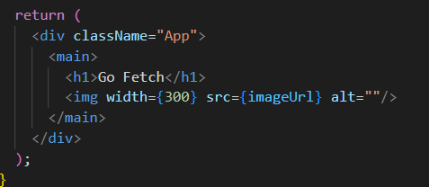
Using external data
In this example, we will create some State and mock up fetching data to update that state. This example will be a simple image that we will pull from the internet
We set a const as a url:
We create empty State
In the return, we set the image src to be the value of imageUrl

Slide 4
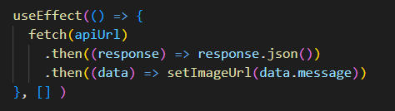
Using external data
All we need to do now is a useEffect and a promise (fetch) to drag down the image and display it.
Notice, this only runs once when the page is initially rendered.
This means, each time we refresh the page it collects the image again, which happens to be random

Slide 5
QuickLab 11
useEffect to collect data

Slide 6
Using JSON Server
We can also use a JSON server, running on our own machines to serve up JSON files.
There is a huge advantage to this, which is that we can add and delete records to the file this way, meaning we can now enact permanent data change

Slide 7
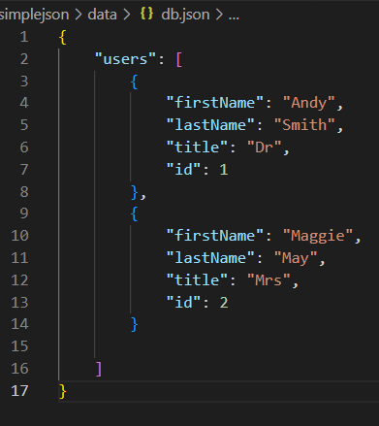
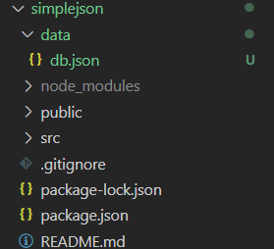
Using JSON Server
We can use NPX to install the JSON server. This is similar to NPM, but pulls in instructions off the web, rather than storing them locally
Notes:
Our structure here is very simple. We created a data folder with a json file inside it called db.json (database). I have included just 2 simple records. The resource of this Json is identified as “users”

Slide 8
Using JSON Server
Because we need to run the JSON server separately, we need to start a new terminal window in VSCode.
Once done, we need to type the following command
--watch allows us to monitor the contents
--port 8000 changes the default (3000) as the react dev server is already running on that one
data/db.json is the path to the data

Slide 9
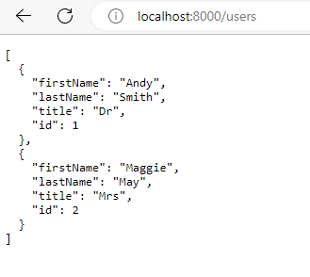
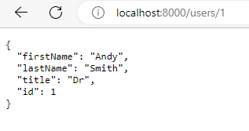
Using JSON Server
When the server is running, open a browser and navigate to:
Notes:
Notice you can navigate to specific records too

Slide 10
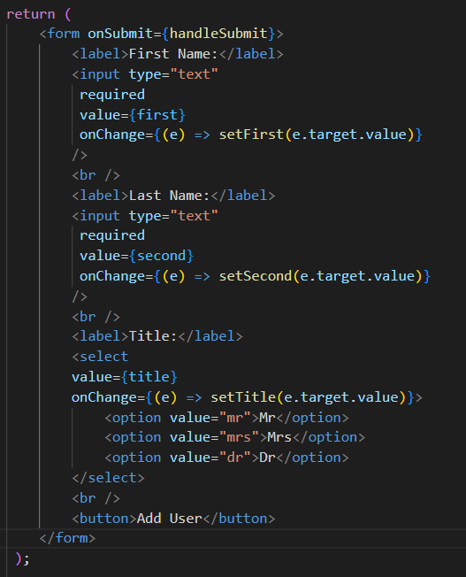
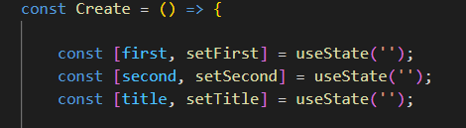
Using JSON Server
We can create some State and a form to allow the user to input the Data
Notes:
Notice you can navigate to specific records too

Slide 11
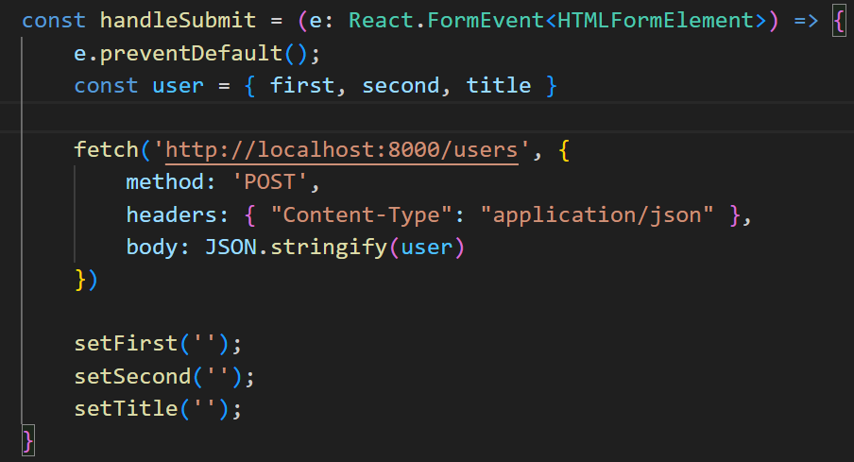
Using JSON Server
Finally, we can use the JSON server to POST the form data to the json file. You can watch it update when you click the submit button

Slide 12
QuickLab 12
Editing Json data with react

Slide 13
CAVEATS
We just saw data fetching inside a component with the useEffect hook.
Although our solution works, and is fine for very simple cases, in an application that is any more complex, this manual way of working has flaws.
Applications that use external data will generally need to
Cache data (tricky)
Track loading states
Avoid duplicate requests
Handle errors
If you tried to implement all of this yourself, you’d be reinventing the wheel. These problems have already been solved by third-party libraries (e.g., react-query).
Notes:
react-query is not covered in this module (you’d need much more time), but it’s good to be aware that such tools exist. They are commonly used as React does not provide very much data-fetching-related functionality out of the box.

Slide 14
HANDS-ON PROJECT
At your own pace, work through
Challenge 1
Challenge 2
Challenge 3

